Slide 1
Summer Internship Project
Alan Li
Notes:
This is my summer internship project presentation. I analyzed extremely hard to borrow stocks to see if Merrill Lynch’s loan rate is predictive of the terminal stock price through time.

Slide 2
What is the stock loan rate?
Need it when shorting a stock
The loan rate is the interest rate Merrill pays on our collateral
The interest rate can be extremely negative
We need to make sure we’re not losing money!
Notes:
Whenever, we want to short a stock, we have to borrow the stock. Usually, we borrow from Merrill Lynch. We pay them collateral for borrowing the stock, and they will pay us interest on the collateral. For stocks that are heavily shorted, this interest rate can be negative, meaning we have to pay Merill Lynch instead! We need to make sure we’re not losing money by choosing to short this stock.

Slide 3
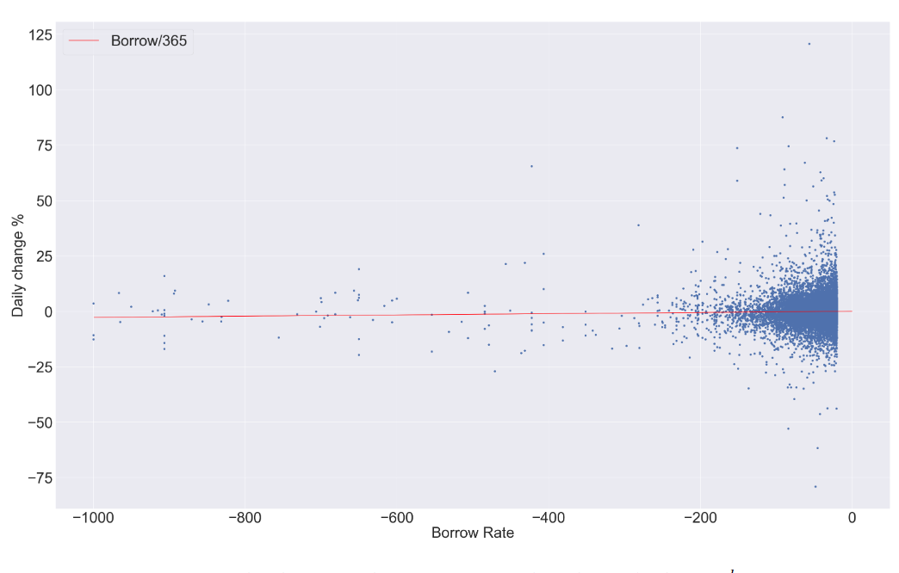
Comparing Loan Rate to Daily Change
Loan rate = daily change of stock
Markets are efficient!
Notes:
We compared the daily change of the stock to the loan rate and conducted a hypothesis test. We found that there was not enough evidence to support that these two rates were different, meaning Merill Lynch is usually fair in the rate that they charge us. The graph shows the loan rate compared to the fair value (red line), and we can see that the points are centered around it.

Slide 4
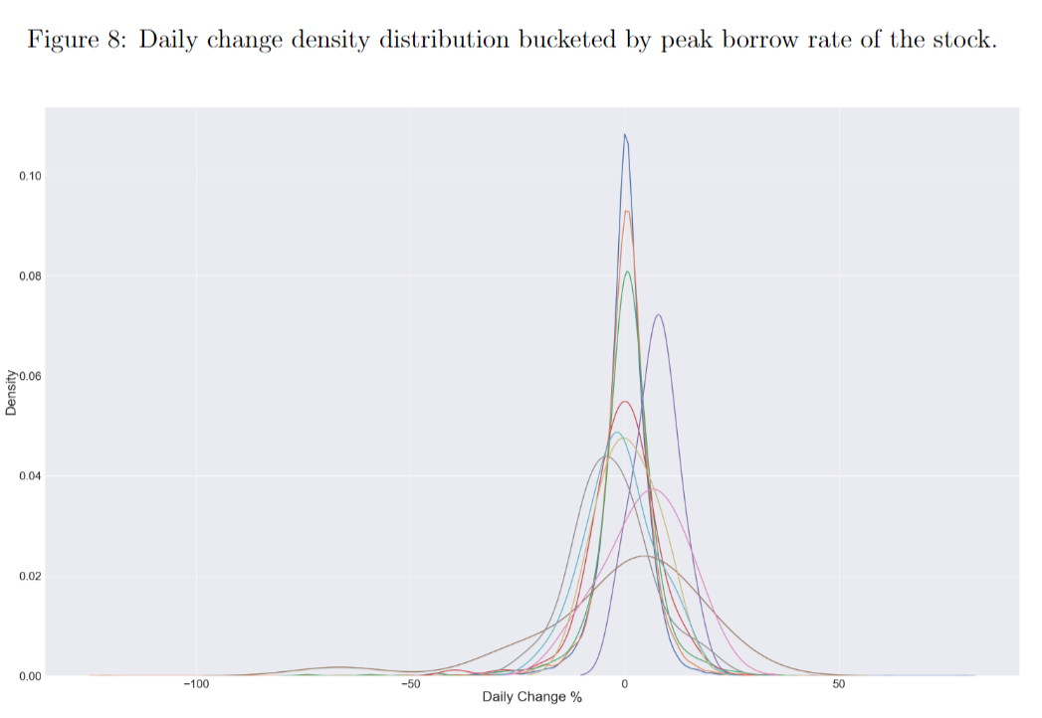
Can we use the loan rate to predict prices?
We found that we can expect a negative drift in the stock when the loan rate is extremely negative.
Notes:
We found that for extremely negative loan rates, we can expect the stock to go down. This makes sense since everyone is trying to short the stock.

Slide 5
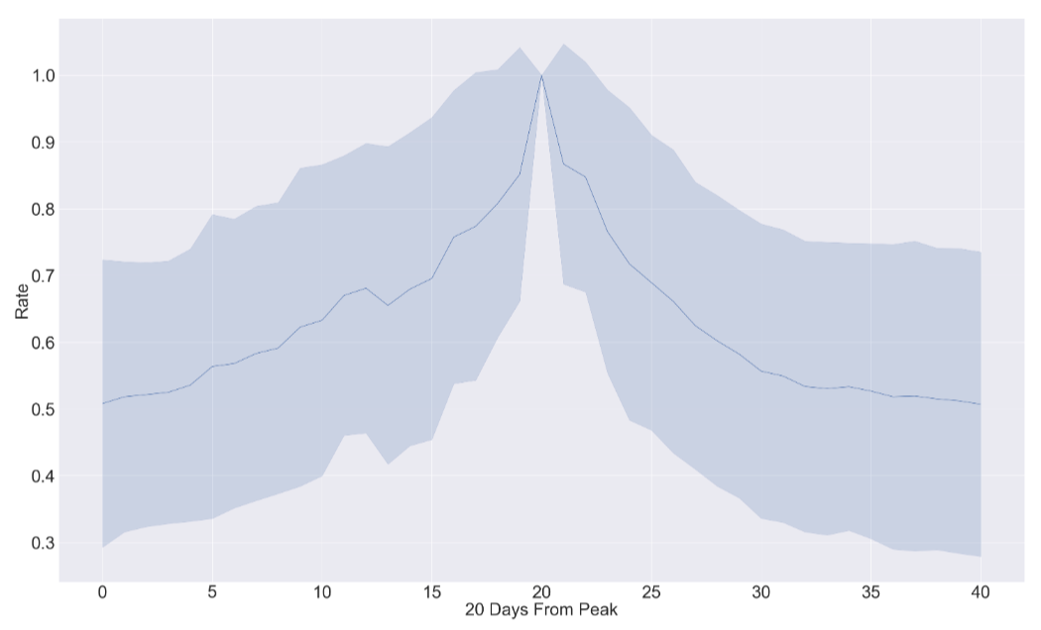
Modelling the rate
Curve is exponential 20 days out from peak negative rate.
Notes:
We also looked at the rate throughout time. We found that the curve was exponential on both sides, as indicated by the graph.

